Slide 2
ASSESSMENT 1

Slide 3
ASSESSMENT 2

Slide 4
ASSESSMENT 3

Slide 5
ASSESSMENT 4
ON ONE REVISION CARD EACH, DRAW A DIAGRAM TO REPRESENT EACH OF THE CIRCLE-ASSOCIATED 3-D SHAPES.
NOTE THE EQUATIONS FOR CALCULATING SURFACE AREA AND VOLUME OF EACH.
GIVE EXAMPLE MEASUREMENTS TO DEMONSTRATE MATHEMATICALLY, AS WELL AS USING a, b, c, x, y, z TO SHOW HOW CALCULATIONS WORK.

Slide 6
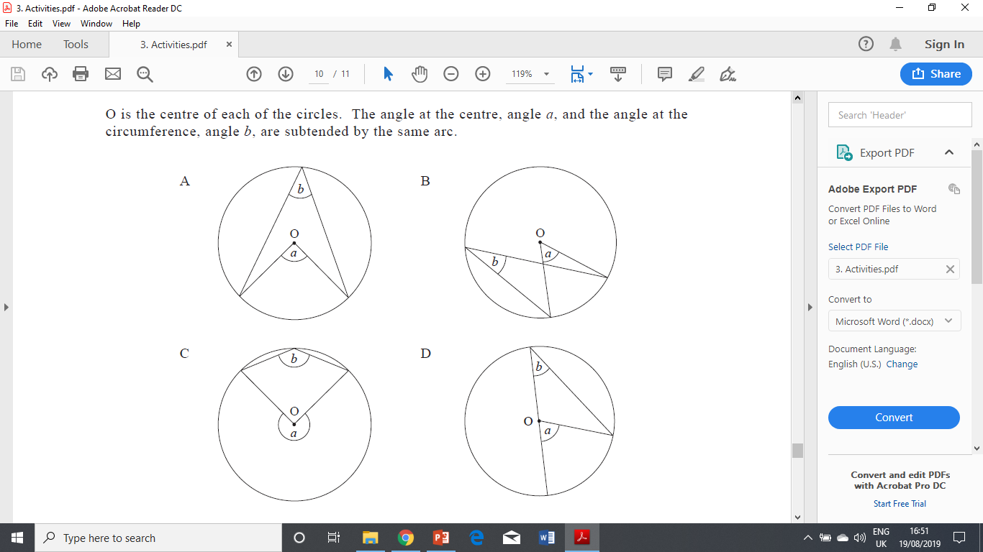
ASSESSMENT 5

Slide 7
ASSESSMENT 6

Slide 8
ASSESSMENT 7

Slide 9
ASSESSMENT 8
ON ONE REVISION CARD EACH, DRAW A DIAGRAM TO REPRESENT EACH OF THE CIRCLE THEOREMS UP TO CIRCLE THEOREM 9.
GIVE EXAMPLE ANGLE MEASUREMENTS TO DEMONSTRATE MATHEMATICALLY, AS WELL AS USING a, b, c, x, y, z TO SHOW HOW ANGLES CORRELATE.
ALSO LABEL THE PARTS OF A CIRCLE (TANGENT, SECTOR, SEGMENT, DIAMETER, CIRCUMFERENCE, RADIUS, CENTRE, etc.)

